Slide 1
ATCSMU100
SMU revision for low systematic power control
Chevy
2019-05
Notes:
https://zoom.us/j/109729231

Slide 2
Agenda
Purpose
AE350_SMU
AE35x power domain
(ATCSMU100)
Block diagram
System registers
  Command/status
Flow Control Sequences
  Software power control flow
  PCS Operation Sequence
AE35x Implementation

Slide 3
Purpose
Revision for low systematic power control
Multiple Power domains
IP
  AE350_SMU → ATCSMU100

Slide 4
AE350_SMU

Slide 5
AE350_SMU
SYSTEMVER - 0x414535_00
Features
  Configurable Root clock / clock ratio
  Core1~3 reset control
  SMU command
    Software reset (whole system)
    Power off main power domain
    Standby command – trigger standby request
  12 clock gating control bits
    Processor/Buses/IPs
  Maskable wakeup events
    External event/RTC/DBG

Slide 6
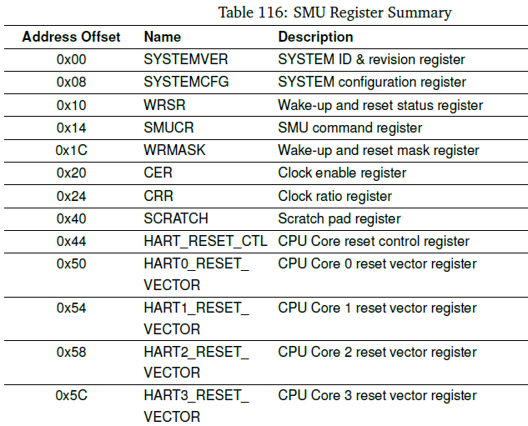
AE350 SMU Registers

Slide 7
PROCESSOR CLOCK OPERATION SEQUENCE
1. Set RTC alarm in the RTC programming register (optional).
2. Set CCLK_EN to 0. (or power off command?)
3. Set standby command of SMU
  • SMU issues an external interrupt to the processor
  • The processor should execute the WFI
4. The Processor clock is disabled after the processor enters the WFI mode.
######
(when a wake-up event arrives)
The Processor clock is enabled and the processor is waked up
Notes:
PROCESSOR CLOCK OPERATION SEQUENCE
1. Set RTC alarm in the RTC programming register (optional).
2. Set CCLK_EN to 0.
3. Set standby command in the SMU command register.
• SMU issues an external interrupt to the processor notifying the standby request.
• The processor should execute the WFI instruction to make the processor go into the WFI
mode.
4. The Processor clock is disabled after the processor enters the WFI mode.
5. The Processor clock is enabled and the processor is waked up when a wake-up event arrives.
6. Clear the SMU command and status registers.
BUS CLOCK OPERATION SEQUENCE
1. Set RTC alarm in the RTC programming register (optional).
2. Set PCLK_EN, HCLK_EN or CCLK_EN to 0.
3. Set standby command in the SMU command register.
• SMU issues an external interrupt to the processor notifying the standby request.
• The processor should execute the WFI instruction to make the processor go into the WFI
mode.
4. The bus clock or processor clock is disabled after the processor enters the WFI mode, depending
on the PCLK_EN, HCLK_EN and CCLK_EN setting.
5. The bus clock is enabled and the processor is waked up when a wake-up event arrives.
6. Clear the SMU command and status registers.

Slide 8
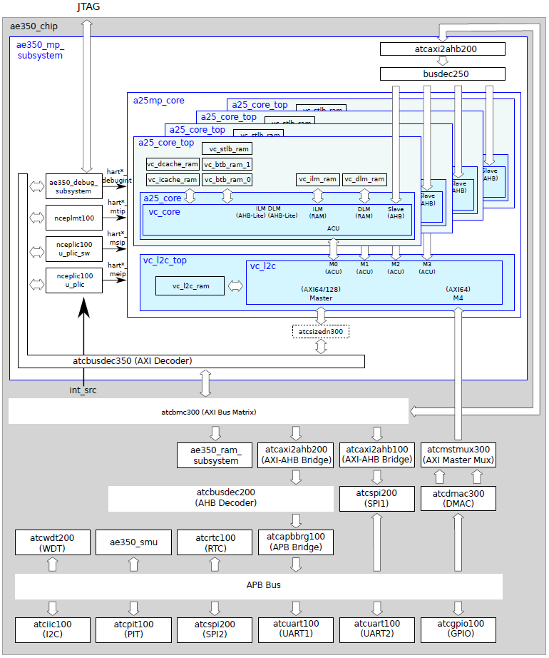
AE35x Power Domain
AlwaysOn
PLDM
MainPD
Core0 (+L2C)
Core1~3

Slide 9
ATCSMU100 v0.7

Slide 10
  Features & Terminologies
Terms
  SMU: System Management Unit
  PCS: Power Control Slot
  PD: Power Domain
  DVFS: Dynamic voltage frequency scaling
Features
  PD/PCS Reset (software reset)
  DVFS
  Light Sleep – clock gated
  Deep Sleep – power off
  Wakeup by events or command

Slide 11
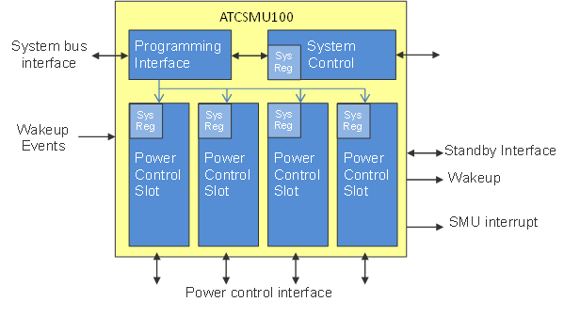
Block Diagram
PD1
PD2
PD3
PD4

Slide 12
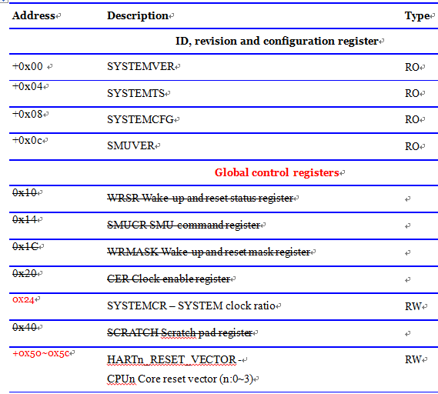
ATCSMU system registers

Slide 13
SMU System Control
SYSTEM ID/Configuration
  ID > 0x414535_00
ATCSMU ID
Core_reset_vectors
system_clock_ratio
  sysclk_sel
  bus_ratio

Slide 14
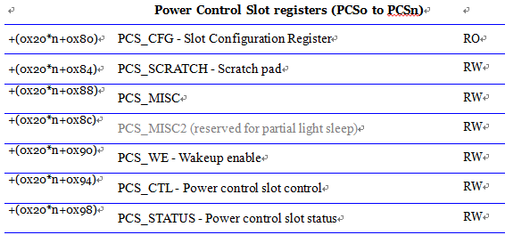
PCS registers

Slide 15
PCS_CFG - Slot Configuration
Name | Bit | Description | Type | Reset
capability | 5:0 | Slot control capability [0]: Reset [1]: DVFS (hardwire 0) [2]: LightSleep [3]: DeepSleep [4]: Cancel from waiting (hardwire 0) [5]: Timeout detection (hardwire 0) | RO

Slide 16
PCS_MISC
Name | Bit | Description | Type | Reset
iso_cyc | 3:0 | ISO cycle – ST_ISO cycles (For DeepSleep) 0: 1 cycle 1: 1 cycle 2: 2 cycles … | RW | 0xf
reten_cyc | 11:4 | RETEN cycle – ST_RET cycles (For DeepSleep) 0: 1 cycle 1: 1 cycle 2: 2 cycles … | RW | 0xff
to_cyc | 27:12 | (Wait standby) Timeout cycle (x16) 0: No timeout 1: 16 cycles 2: 32 cycles … | RW | 0
mem_init0 | 28 | MEM0 Reset Initialization 0: 1: The Reset Initialization is required on MEM0 | RW/RO* | 1/0
mem_init1 | 29 | MEM1 Reset Initialization | RW/RO* | 1/0
mem_init2 | 30 | MEM2 Reset Initialization | RW/RO* | 1/0
mem_init3 | 31 | MEM3 Reset Initialization | RW/RO* | 1/0

Slide 17
PCS_WE - Wakeup enable
Name | Bit | Description | Type | Reset
wakeup_en | [31:0] | bit[n]=1: Enable corresponding wakeup event[n] [0]: wakeup by PCS wakeup command. (hardwire1) | RW | 0xffffffff
AE35x wakeup events (2 harts)
NO. | Signal | Description
0 | - | PCS wakeup command
20:1 | int_src[20:1] | PLIC interrupt source
21 | dbg_wakeup_req | ae350_debug_subsystem debug request (from ncejdtm200)
22 | X_wakeup_in; | External wake-up event
28 | debugint | from ae350_debug_subsystem PCS[default].wakeup_event.debugint = hart0_debugint PCS[core0].wakeup_event.debugint = hart0_debugint PCS[core1].wakeup_event.debugint = hart1_debugint
29 | sip | PLIC_SW interrupt target PCS[default].wakeup_event.msip = hart1_msip PCS[core0].wakeup_event.msip = hart0_msip PCS[core1].wakeup_event.msip = hart1_msip
30 | tip | PLMT PCS[ default ].wakeup_event.mtip = hart0_mtip PCS[core0].wakeup_event.mtip = hart0_mtip PCS[core1].wakeup_event.mtip = hart1_mtip
31 | eip | PLIC interrupt target(*=m/s/u) PCS[ default ].wakeup_event.eip = hart0_*eip PCS[core0].wakeup_event.eip = hart0_*eip PCS[core1].wakeup_event.eip = hart1_*eip

Slide 18
PCS_CTL - Control
Name | Bit | Description | Type | Reset
cmd | 2:0 | Power control Command. 0: Active 1: PCS_reset* 2: DVFS 3: Sleep | RW* | 0
param | 7:3 |  | RW* | 0
* Hardware protection on Write operation
* Globally reset by PCS0.PCS_resrt (aka. sw_rst on ae350_smu)
cmd | param
Active | 1: wakeup 2: Cancel from waiting state
PCS_reset | minimal Reset cycles
DVFS | DVFS factor (level)
Sleep | 0: LightSleep 1: DeepSleep
Notes:
Hardware protection on Write operation:
When the PCS is in Busy_Wait state, the Write operation is waived and it can be detected in PCS_STATUS.cmd_status.
When the PCS is not in Busy_Wait state, the PCS_CTL will be updated. An interrupt occurs when the command is not supported or is illegal on current state. The wrong PCS command can be detected in PCS_STATUS.cmd_status.
Read operation: The field will be cleared after the command finishes.

Slide 19
PCS_STATUS
Name | Bit | Description | Type | Reset
PD_type | 2:0 | 0: Active 1: Reset 2: Sleep 3: Busy_Wait 7: Timeout | RW* | 1
PD_status | 7:3 | (See the next slide) | RW* | 0
cmd_status | 10:8 | 0: Command successful 1: Cancel successful 6: waive PCS command ( no pend_int) 7: Unsupported/Wrong PCS command (fire pend_int) | RW | 0
DVFS | TBD | DVFS factor | RO | 0
wakeup_int | 30 | Pending wakeup interrupt. The bit is asserted when the PD_type is changed to Active by PCS. | W1C | 0
pend_int | 31 | Pending interrupt. The bit is asserted when the PD_type is changed to Timeout by PCS or the cmd_status is 7. | W1C | 0

Slide 20
PCS_STATUS.PD_status
PD_type | PD_status
Active | Wakeup cause. Wakeup from non-masked pending event (vector). 0: Wakeup from PCS or DVFS done 1: wakeup event 1…
Reset | Reset cause: [3]: global power-on reset [4]: PCS_reset (SW reset in SMU v0) [5]: implementation dependent (WDT on AE35x) [6]: implementation dependent (T_hw on AE35x) [7]: implementation dependent (X_por_b on AE35x)
Sleep | Sleep mode: 0: LightSleep 16: DeepSleep
Busy_Wait | 0: waiting on Reset 1: waiting on DVFS 2: waiting on LightSleep 3: waiting on DeepSleep 16: Busy on Reset 17: Busy on DVFS 18: Busy on LightSleep 19: Busy on DeepSleep

Slide 21
Flow Control Sequences

Slide 22
System view for power control
Core control
Normal
Software
procedure
Software
procedure
WFI
Core
Reset*
Hardware
handshaking
Hardware
handshaking
Power down sequence
Power on sequence
PowerDown
/DVFS
SMU control

Slide 23
Power down sequence
Software procedure by Core
  Disable interrupt-enable bit (mstatus.mie)
  Flush cache(s)
  Program save CSR/RF/FRF status and resume PC to memory
  Execute SMU power down command & WFI
Hardware handshaking by SMU
  Waits core_wfi_mode asserted from core
  Disable clock
  (DeepSleep) Enables isolation/retention cell
  (DeepSleep) Asserts reset signal
  (DeepSleep) Disable power

Slide 24
Power on sequence
Hardware handshaking by SMU
  Power on sequence is triggered by Wakeup events
  (DeepSleep) Enable power
  (DeepSleep) De-assert reset signal
  (DeepSleep) Assert coren_reset_vector to restore program
  (DeepSleep) Disable isolation/retention cell
  Enable clock
Software procedure by Core
  Exit from WFI by unmasked pending interrupts
  Redirect PC to software restore program
    Software restore CSR/RF/FRF status from memory
  Restore interrupt-enable bit (mstatus.mie)
  Redirect PC (to previous program sequence)

Slide 25
Example of Software programming sequence
Core0 asks Core1 to sleep modes
  Core0 send power command to SMU for Core1
  Core0 inform Core1 to enter WFI mode
    or SMU inform Core1
  SMU handles power command
  Core1 enters sleep modes
  (Sleeping)
  Core1 wakeup by Core0 via Software PLIC
    or wakeup by SMU
Notes:
AE350_SMU
PROCESSOR CLOCK OPERATION SEQUENCE
1. Set RTC alarm in the RTC programming register (optional).
2. Set CCLK_EN to 0.
3. Set standby command in the SMU command register.
• SMU issues an external interrupt to the processor notifying the standby request.
• The processor should execute the WFI instruction to make the processor go into the WFI
mode.
4. The Processor clock is disabled after the processor enters the WFI mode.
5. The Processor clock is enabled and the processor is waked up when a wake-up event arrives.
6. Clear the SMU command and status registers.

Slide 26
PCS Operations

Slide 27
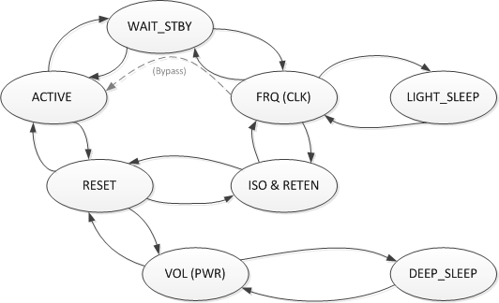
PCS Operation FSM
Notes:
DVFS (TBD)

Slide 28
AE35x Implementation

Slide 29
AE35x Power Domain Partition
AlwaysOn
PLDM
MainPD
Core0 (+L2C)
Core1~3

Slide 30
AE35x Connection
PLIC interrupt source
  int_src[23] = pcs_cpu0_standby_req; // target: cpu0
  int_src[24] = pcs_cpu1_standby_req; // target: cpu1
  int_src[25] = pcs_cpu2_standby_req; // target: cpu2
  int_src[26] = pcs_cpu3_standby_req; // target: cpu3
  int_src[27] = pcs_cpu0_wakeup; // target: cpu0
  int_src[28] = pcs_cpu1_wakeup; // target: cpu1
  int_src[29] = pcs_cpu2_wakeup; // target: cpu2
  int_src[30] = pcs_cpu3_wakeup; // target: cpu3
  int_src[31] = |pcs_int; // target: cpu0
    pcs_standby_ok
      pcs_standby_ok[default] = hardwire 1
      pcs_standby_ok[core0] = hart0_core_wfi_mode & l2c_pcs_standby_ok
      pcs_standby_ok[core1..3] = hart[1..3]_core_wfi_mode
    pcs_mem_init
      icache_disable_init = pcs_mem_init[o]
      dcache_disable_init = pcs_mem_init[1]
      l2c_disable_init = pcs_mem_init[2]

Slide 31
Control path On AE35x (1/)
Sleep I
  PCS[core1].CmdSleeps
  PCS[core1] FSM
  pcs_standby_req[core1]
  core1[meip] (&meie)
  core1.WFI
  pcs_standby_ack
  PD[core1] clock off
Sleep II
  PCS[core1].CmdSleeps | core1.WFI
  PCS[core1] FSM | pcs_standby_ack
  PD[core1] clock off

Slide 32
Control path On AE35x (2/)
Wakeup I
  PCS[core1].CmdWakeup
  PCS[core1] FSM
  PD[core1] clock on
Wakeup II
  core1[mti/msi]
  PCS[core1] FSM
  PD[core1] clock on
  PCS[core1].wakeup
  core1[mei]
  core1 exit WFI
  PCS[core1].wakeup
  core1[mei]
  core1 exit WFI
PCS[core1].wakeup
core0[mei]
core0 fire core1[msi]
core1 exit WFI
core1[mti/msi]
core1 exit WFI

Slide 33
Thank You!

Slide 34
TMP

Slide 35
Power mode definition
DVFS
  Purpose: Dynamic change power for workload requirement
  Function: Change voltage and frequency
  Latency: For voltage/clock source, it might takes ms scale for scaling and stable.
Light Sleep
  Purpose: Fast response for interrupt and save power
  Function: Core and RAM are clock-gated.
  Latency: fast for enabling clock switch
Deep Sleep
  Purpose: Stop core and save most power
  Function: Core and RAM are powered off.
  Latency: For voltage/clock source, it might takes ms scale for turn-on and stable.

Slide 36
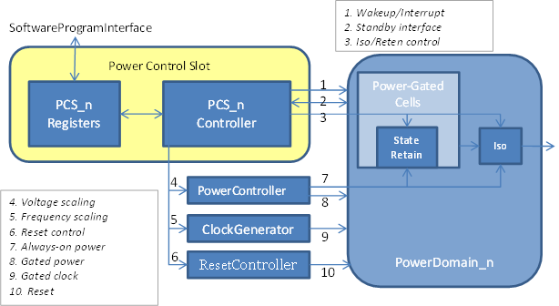
Power Control Slot

Slide 37
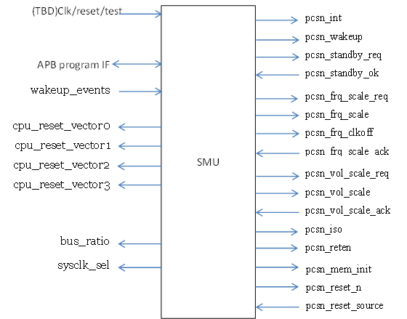
Interface

Slide 38
Architecture state backup & recovery
Baseline RV32/64 register file (x1 ~ x31)
Floating point RVF/D register file (f0 ~ f31)
CSRs
  Status CSRs
  Trap CSRs
  PMP CSRs
  HPM CSRs
  Debug CSRs
  AndeStarV5 CSRs

Slide 39
PCS Operation Sequence (1/)
Before an new operation
  Check/Clear status/interrupts
  Initialize PCS_WE, PCS_MISC …
PCS Reset operation
  Write PCS_CTL
    cmd = PCS_reset
    param = Reset cycle count
  The reset will be asserted for specific cycles
  The PD goes to ACTIVE state.
    PCS_STATUS. PD_Type = Reset
    PCS_STATUS. PD_Status = PCS_reset

Slide 40
PCS Operation Sequence (2/)
PCS LightSleep operation
  Write PCS_CTL
    Sleep.LightSleep
  PCS goes to ST_Wait_Standby
    Pcs_standby_req is asserting and waiting for pcs_standby_ok
  The clock is gated after the pcs_standby_ok asserted
  The PD goes to LightSleep state
    PCS_STATUS = Sleep.LightSleep

Slide 41
PCS Operation Sequence (3/)
PCS DeepSleep operation
  Write PCS_CTL
    Sleep.DeepSleep
  PCS goes to ST_Wait_Standby
    Pcs_standby_req is asserting and waiting for pcs_standby_ok
  The clock will be gated after the pcs_standby_ok asserted
  The isolation/retention cells are enabled
  The reset is asserted and then the power is gated
  The PD goes to DeepSleep state.
    PCS_STATUS = Sleep.DeepSleep

Slide 42
PCS Operation Sequence (4/)
PCS Wakeup operation
  The PD is under DeepSleep/LightSleep state
  Wakeup occurs
    Wakeup by PCS
      PCS_CTL = Active.wakeup
    Non-masked wakeup event occurs
  (from DeepSleep) The power is supplied and then the reset is de-asserted
  (from DeepSleep) The isolation/retention cells are disabled and the state is recovered.
  The clock is generated
  The PD goes to Active state
    PCS_STATUS. PD_Type = Active
    PCS_STATUS. PD_Status = event vector
    pcs_wakeup is asserted

Slide 43
PCS Operation Sequence (5/)
PCS Wakeup operation (in WAIT_STBY state)
  The PD can be wakeup immediately from ST_WAIT_STBY.
  The PD is under WAIT_STBY state
    Pcs_standby_req is asserting and waiting for pcs_standby_ok
  Wakeup occurs
    Wakeup by PCS
      PCS_CTL = Active.wakeup
    Non-masked wakeup event occurs
  The PD goes to Active state after the pcs_standby_ok asserted
    PCS_STATUS. PD_Type = Active
    PCS_STATUS. PD_Status = event vector
    pcs_wakeup is asserted

Slide 44
Debug Wakeup
dbg_wakeup_req
NCEJDTM200
(Always On)
NCEPLDM200
(Power off)
NCEJDTM200
(Always On)
NCEPLDM200
(Power off)
1. Target Power on
2. Start Debug Option (Start ICEMan)
* dbg_wakeup_req = 1 when jtag leave IDLE state
dbg_wakeup_req
NCEJDTM200
(Always On)
NCEPLDM200
(Wake Up)
NCEJDTM200
(Always On)
NCEPLDM200
(Wake Up)
3. SMU wake up PLDM
4. PLDM keeps alive until the system is reset by reset buttom
* dbg_wakeup_req keeps 1

Slide 45
PCS/PD Reset

Slide 46
LightSleep

Slide 47
DeepSleep

Slide 48
DVFS

Slide 49
Retention components
(TBD)
Mems
CSRs

Slide 50
Legal combinations of power states
Level | PLDM | MPD | core 0 | core 1 | core 2 | core 3
0 | ON/- (OFF) | - (OFF) | - | - | - | -
1 | ON/- | ON | - | - | - | -
2 | ON/- | ON | HI/LO | - | - | -
3 | ON/- | ON | HI/LO | HI/LO | - | -
4 | ON/- | ON | HI/LO | HI/LO | HI/LO | -
5 | ON/- | ON | HI/LO | HI/LO | HI/LO | HI/LO

Slide 51
TODO
DVFS
Clock gated by individual IP

